Slide 1
#IndianElection2019
Detecting Trolls on Twitter Group 3: Atindra, Helena, Kirti, Preetika
Notes:
Namaste everyone! Welcome to bharatiya chunav 2019. For those of us who don’t speak Hindi, we detected trolls on Twitter who have been affecting the conversation during the 2019 Indian Election.

Slide 2



Context
Election of the world’s largest democracy
BJP & Congress are the 2 major political parties
300M of eligible voters are active on social media
Notes:
Largest Democracy in the World going to elections in 2019 (World’s largest democratic election) Complicated political system with 2 major political parties (BJP and Congress) fighting the elections More than a third (~300M) of the eligible voters are active on social media, who can play a major role in deciding the election trends and results

Slide 3
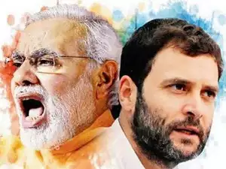
Modi vs. Rahul Gandhi
Notes:
The conversation surrounding the election is strong centered on these two guys - Modi & Rahul Gandhi.
Modi is the current PM of India & part of the BJP party
Rahul Gandhi is his main opponent & member of the Congress party

Slide 4
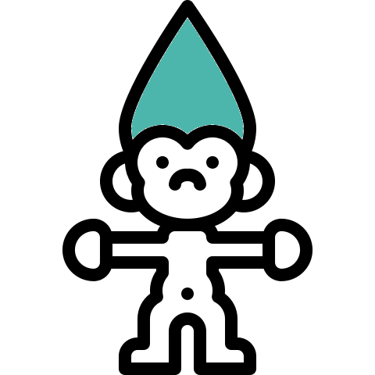
Objective
To identify
trolls in the 2019 Indian election
structure of trolls’ movements
Identify each party’s use of trolls to slander

Slide 5
Data
Scraped 18K tweets with hashtags including: #RahulGandhiChorHai, #GoBackModi, #NamoAgain #RahulGandhiLieChallenge #IndianElections2019, etc …
Created 2 datasets: Anti-Modi & Anti-RaGa
Notes:
preetika
Talk about hypothesis
Tweets were from this week!

Slide 6
Approach
Generated NetworkX graphs
Calculated centrality measures and observed changes in connectivity
Obtained the k-cores to identify troll groups, which worked together for their respective sides
Identified the trolls and generated insights
Notes:
Identify connectivity in the network
Know that you can find

Slide 7
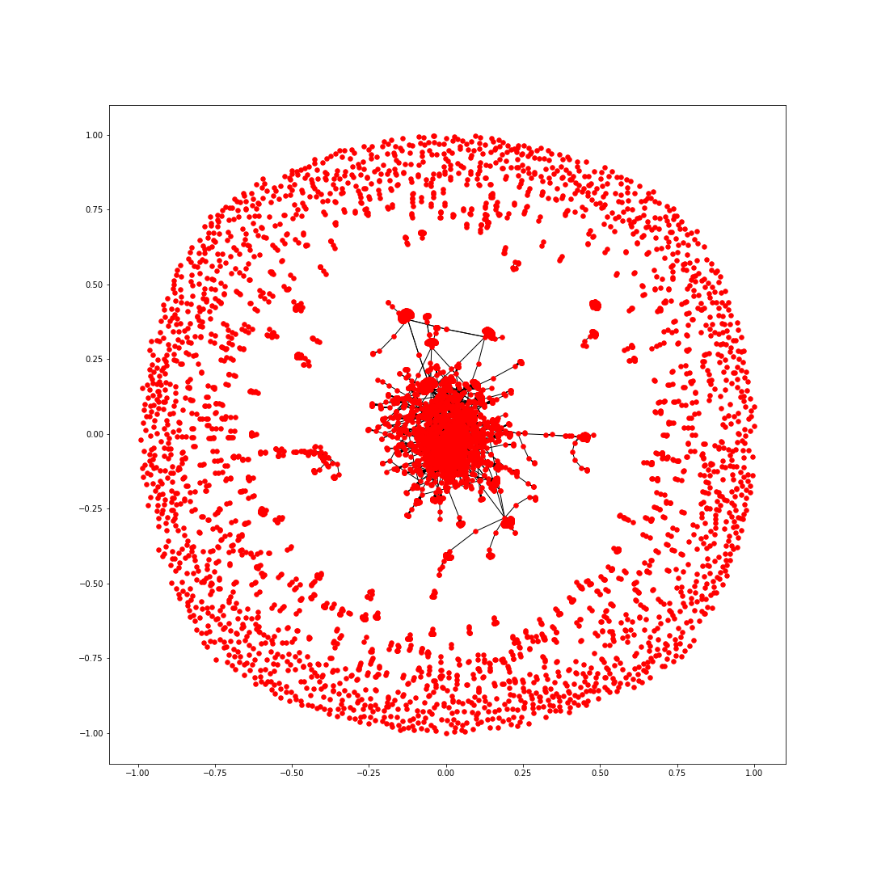
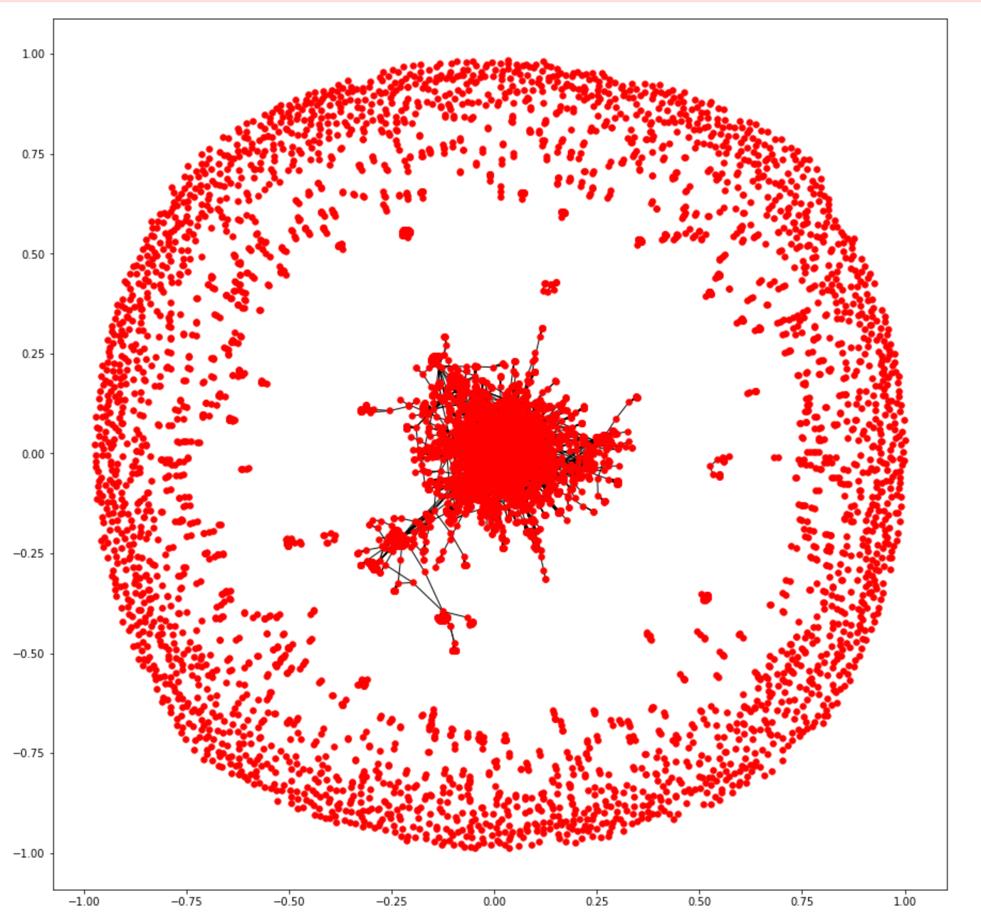
Anti-Modi
Anti-Rahul
Modi vs. Rahul Network Graphs
Notes:
Helena
Like Preetika mentioned, we first generated a basic network graph of all the nodes in the network. We can definitely see theres a presence of influencers at the center of the cluster

Slide 8
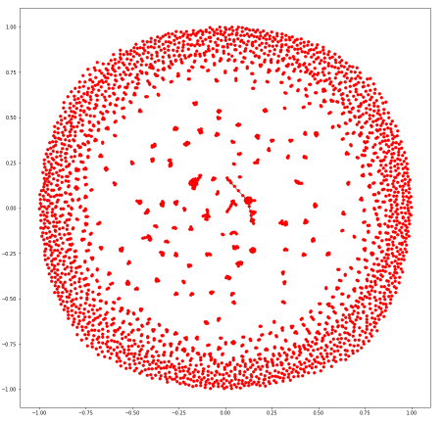
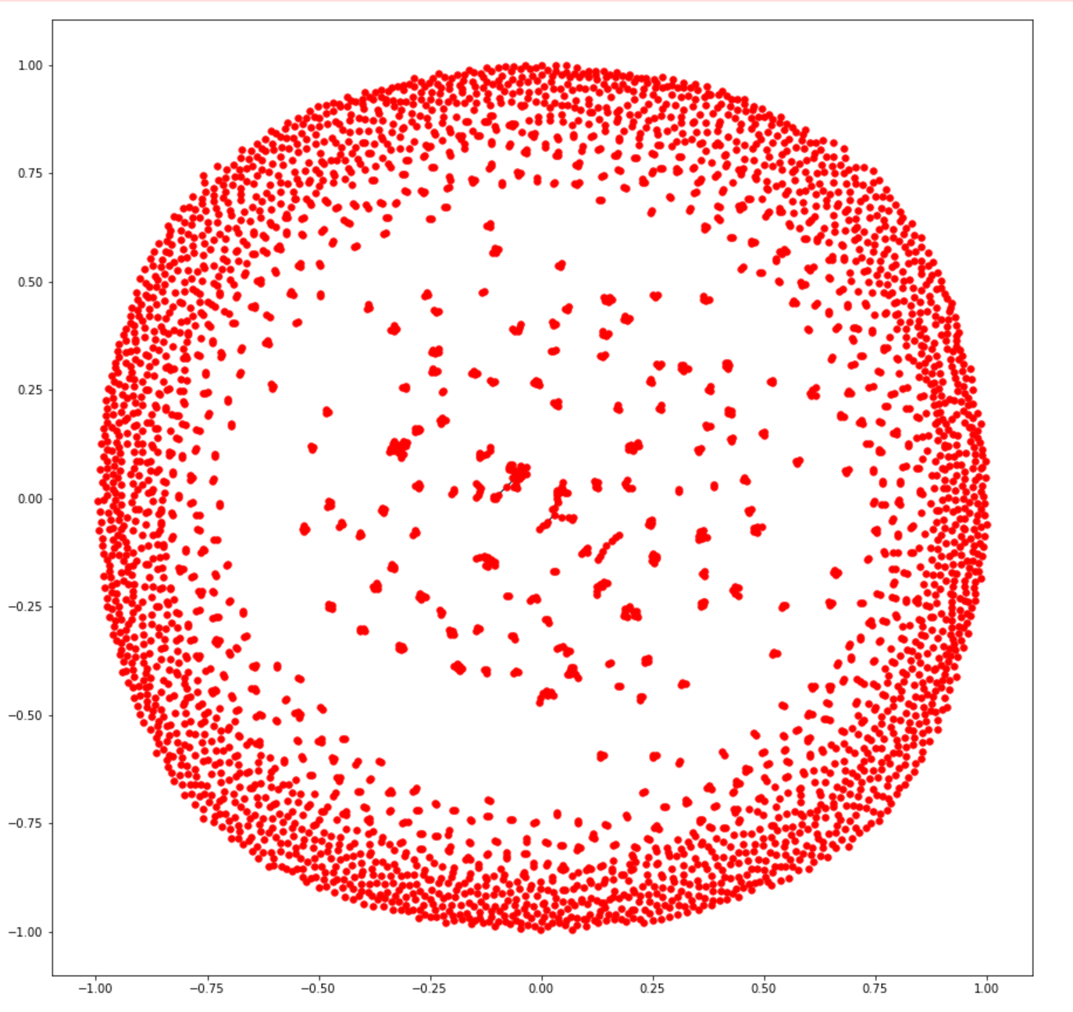
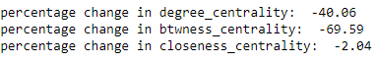
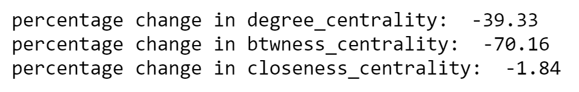
Anti-Modi
Anti-Rahul
Influentials Removed - centrality decreases significantly
Notes:
Calculated centrality measures including degree, betweenness, and closeness of each node, sorted them, and removed the top 5% of users w/ highest centrality scores. The result is what’s shown above. From this pizza, we can see that the network is much more disjoint!
Numerically, we can also see that there was about a 40% decrease in centrality for both groups.
This shows there’s a probably presence of trolls because, from their frequent activity, they are people that connect other disjoint users together.

Slide 9
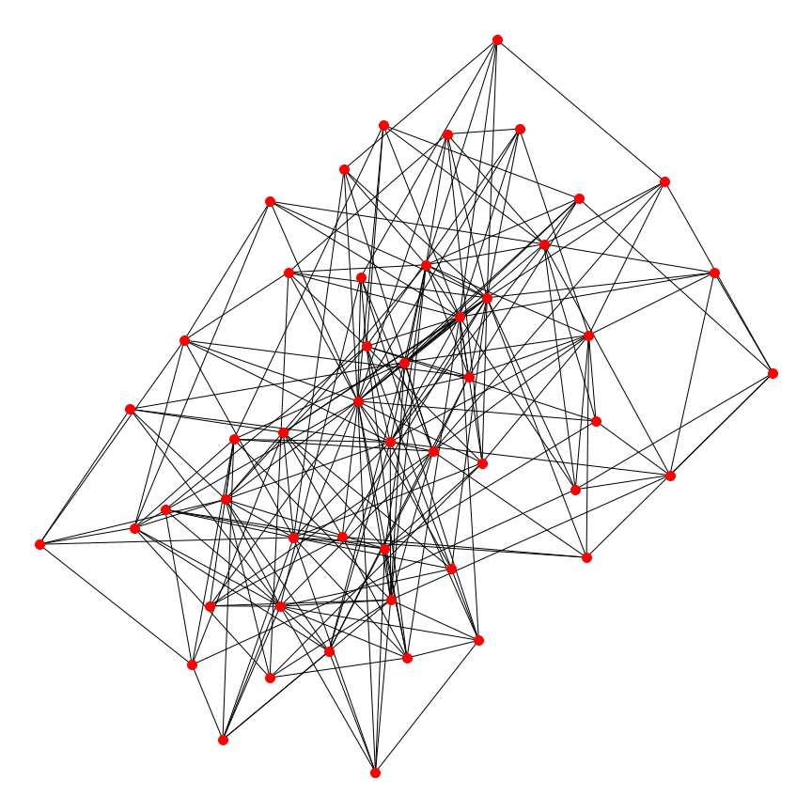
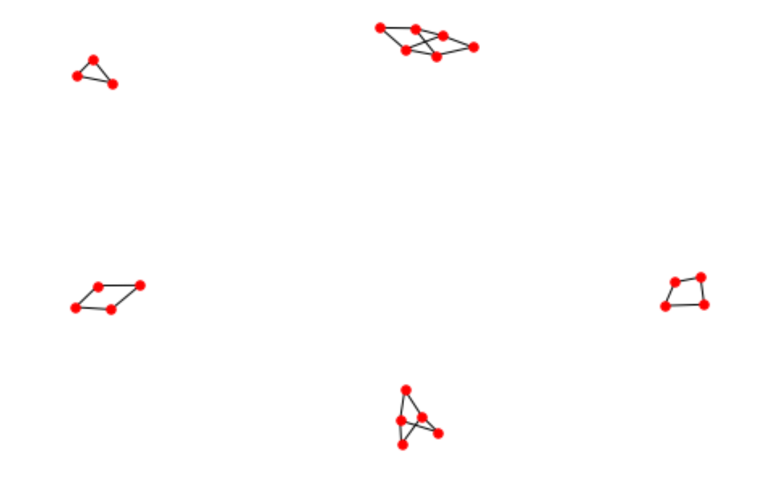
Anti-Modi
Anti-Rahul
K=6
K=2
K-core Subgraphs: Maximal cores in sub-graphs
Notes:
Based on our hypothesis that trolls operate in groups, we also found the k-cores for each group.
Anti - modi = max k-core is 6
Anti - Rahul = 2
This is a particularly interesting insight - it shows how well connected the possible trolls in modi’s group are, that there may be more of a unified movement behind it that’s anti-modi.
We went forward to investigate the individual users of these k-core networks, assuming that among them there was most likely at least one troll, if not all.

Slide 10
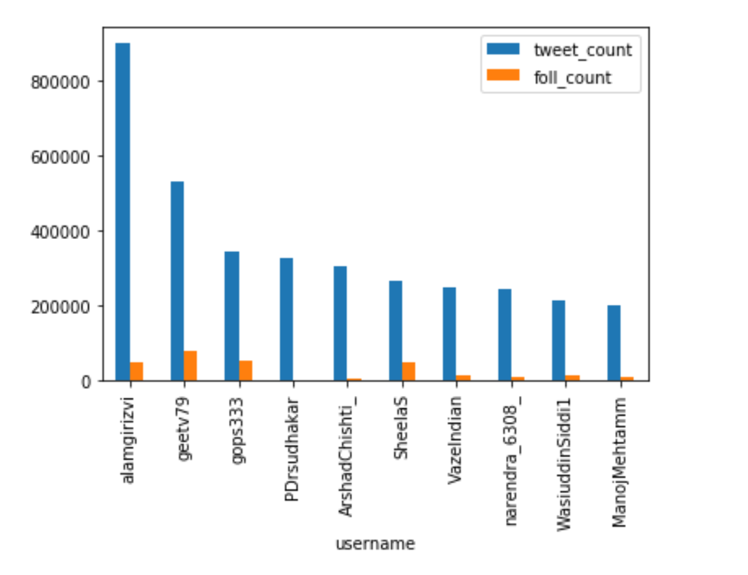
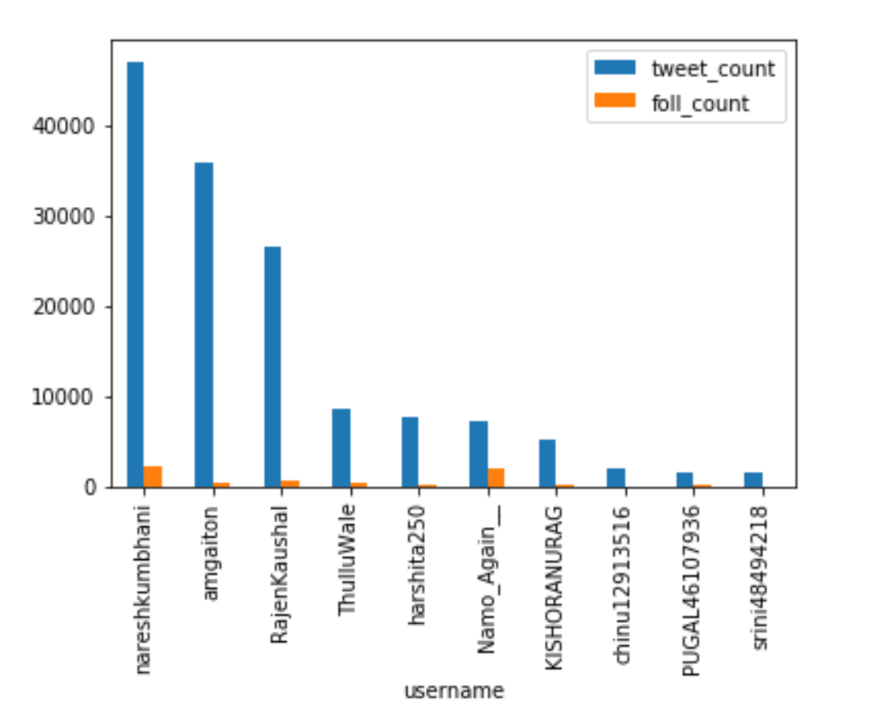
A comparison of Anti-Modi vs. Anti-Rahul trolls
Notes:
Kirti
Investigated nodes of the k-core
Thes are the nodes who had the highest number of tweets in each graph
Set of people with a lot of activity. Since we know trolls for high activity & have a lot of people following them.
Tweet & follower count of the identified trolls in from our k-cores

Slide 11
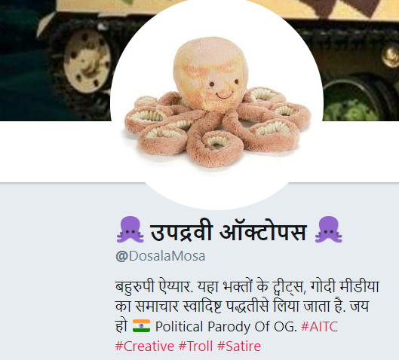
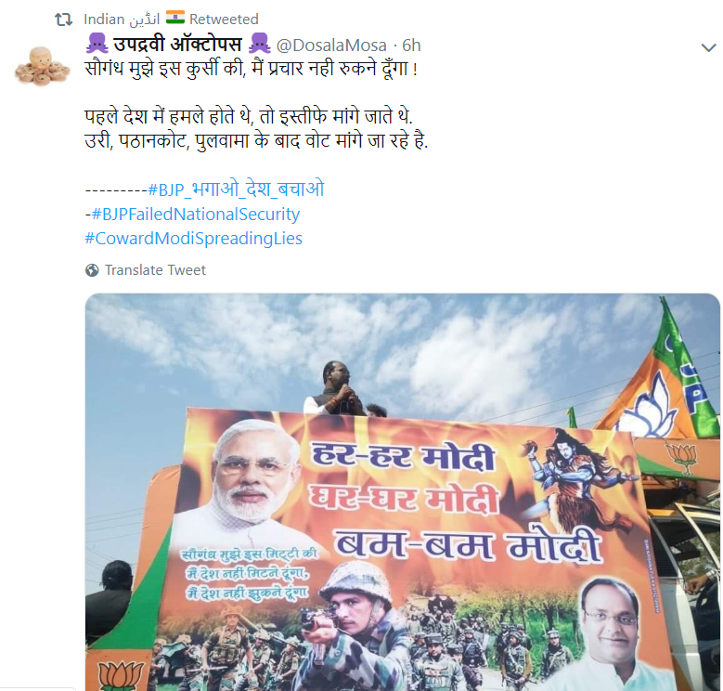
Anti-Modi Trolls

Slide 12
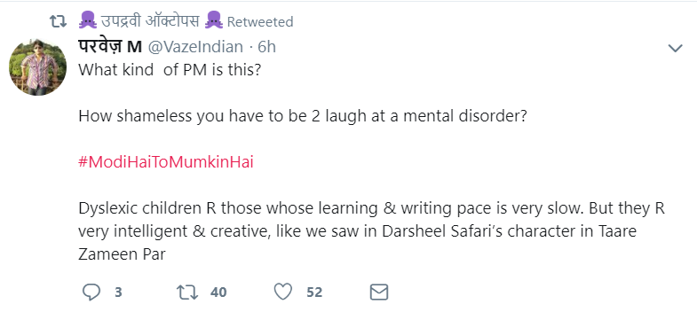
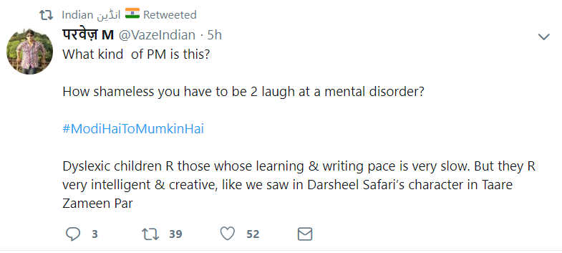
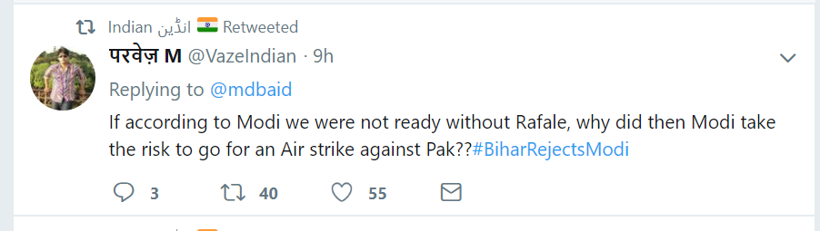

Slide 13
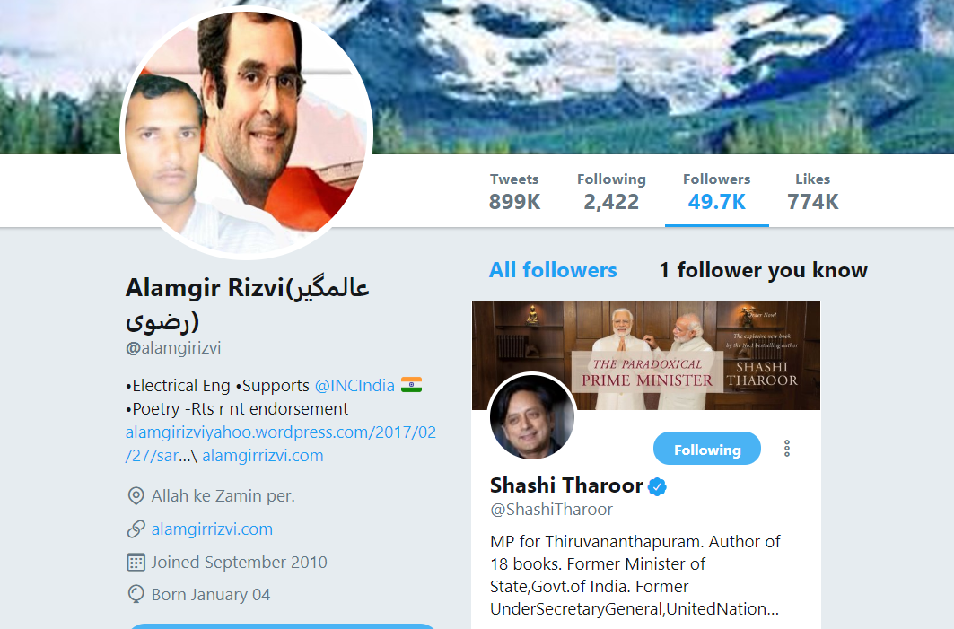
Famous Personality Following Anti-Modi Trolls?
Appears in our network of Anti-Modi Trolls
Shashi Tharoor, a prominent Congress politician, follows him

Slide 14
Insights
There is a strong presence of trolls for both entities involved
Trolls against Modi are more organized and more influential than the trolls against RaGa
Trolls against RaGa aren’t as influential and prominent in comparison to trolls against Modi
Prominent personalities do follow a few trolls especially those with a large number of followers

Slide 15
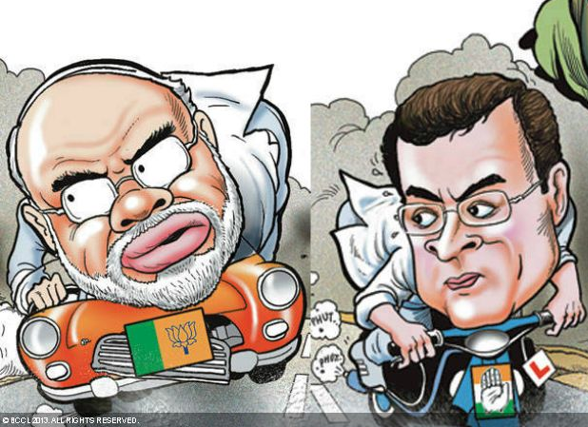
Thank you! Questions?

Slide 16

